Slide 1
COMP 3500 Introduction to Operating Systems Project 4 – Processes and System Calls Part 4: Managing File System State
Dr. Xiao Qin
Auburn University http://www.eng.auburn.edu/~xqin
xqin@auburn.edu
Notes:
No demonstration cs161-gdb due to the lack of time
b sys_reboot
Bt
Slides 1-13: 45 Minutes.

Slide 2
Review: How to Test System Calls?
Step 1 Create a User Program for the New System Call
Step 2 Run the User Program in OS/161

Slide 3
Step 1.1 Create a new directory using forktest as a template
We place all the test programs in the following directory:
~/cs161/src/testbin
Each test program and its associated files (e.g., Makefile) are organized in a dedicated directory.
Create a new directory using forktest as a template
%cd ~/cs161/src/testbin
%cp –r forktest getpidtest

Slide 4
Step 1.2 Change source code name
%cd getpidtest
%mv forktest.c getpidtest.c

Slide 5
Step 1.3 Modify getpidtest.c
#include <unistd.h>
#include <stdio.h>
int main() {
int mypid;
mypid = getpid();
reboot(RB_REBOOT);
return 0;
}

Slide 6
Step 1.4 Modify Makefile and depend.mk
Modify Makefile and depend.mk by replacing forktest with getpidtest

Slide 7
Step 1.5 Compile getpidtest.c
Compile getpidtest.c using cs161-gcc. This can be done through running Makefile as below.
%make
The make utility program compile getpidtest.c and generate an execute file called getpidtest

Slide 8
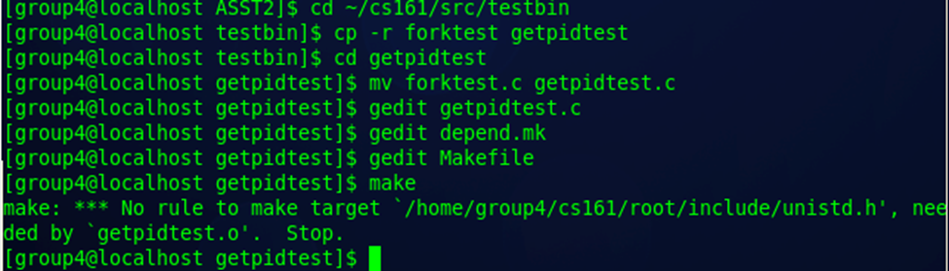
A Sample Problem with Makefile
File getpidtest.c doesn’t exist
You're in the wrong directory when you run make
Check your Makefile
getpidtest.o: getpidtest.c getpidtest.h
gcc -c getpidtest.c
No space, TAB only
No comma

Slide 9
Step 1.6 Copy the executable file to the root directory
Copy the executable file getpidtest into ~/cs161/root/testbin
%cp getpidtest ~/cs161/root/testbin/getpidtest
The above executable file will be loaded by OS/161 through the p command in the main menu.

Slide 10
Step 2 Run the User Program in OS/161
You can follow the instructions below to run the testing program created in Step 1:
%cd ~/cs161/root
%./sys161 kernel
In the menu prompt type:
p /testbin/getpidtest

Slide 11
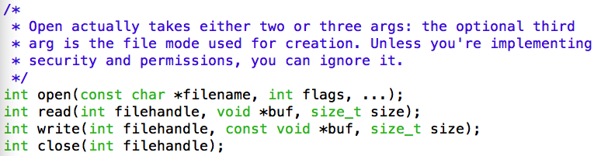
System Calls Related to File Systems
~/cs161/src/include/unistd.h

Slide 12
System Calls Interface
You can find a sample user application here:
Notes:
Question 1:
Where can you find the prototype of open(filename, flags, …)?
Answer: ~/cs161/src/include/unistd.h
Question 2:
Where do you declare the prototype of sys_open(filename, flags, …)?
Answer: ~/cs161/src/kern/include/syscall.h

Slide 13
Data Structure Questions 1. How to represent opened files for each process? 2. Where should you keep the above information?
Two-minute group discussion
Do not consider data structure for storing and organizing data in files
Focus on meta data of files
Notes:
Not the data structure to store and organize data in files
Let’s focus on meta data of files

Slide 14
Data Structure Question 1: How to represent opened files for each process?
Answer:
The openfile structure
An array (or list) of openfile items: openfileTable
The array is referred by a File Descriptor (FD)
Each opened file has an openfile struct
Read()/write()/lseek() use file descriptor to operate each opened file
Notes:
a file descriptor (FD) is an abstract indicator for accessing a file.

Slide 15
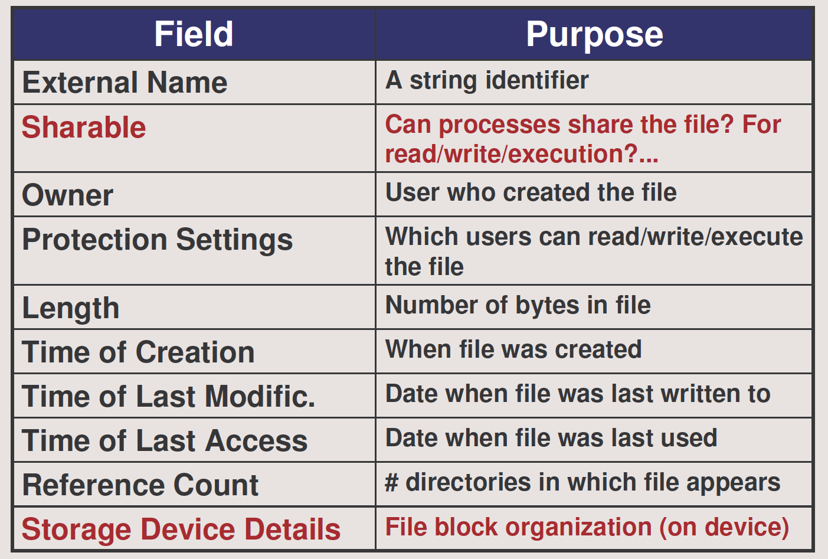
What are inside the openfile structure?
Notes:
Not the data structure to store and organize data in files
Let’s focus on meta data of files

Slide 16
How will you design the openfile structure?
File pointer:
To locate data
A pointer to vnode (How to obtain it?)
vnode is defined in
src/kern/include/vnode.h
Mode: Read-only, write-only, read-write, etc.
Offset
Lock
Reference count
From vfs_open()
Notes:
Not the data structure to store and organize data in files
Let’s focus on meta data of files

Slide 17
User-Level Interface for System Calls src/include/unistd.h
fid = open(“fileA”, flags);
…
read(fid, buffer, len);
On-Device File Descriptor
0 stdin
1 stdout
2 stderr
3 ...
openfile struct
inode
openfile Table
Internal File Descriptor
In OS161: vnode

Slide 18
Design Question 1 Can a file be opened multiple times?
Have two separate openfile struct
Indicated by two file descriptors
Notes:
Not the data structure to store and organize data in files
Let’s focus on meta data of files

Slide 19
Design Question 2 Will openfile be shared by concurrent threads?
No. You do not need to deal with the critical section issue.
Consider this first
Yes. You need use lock implemented in project 3 to protect this shared openfile
If you have time, implement this feature
Question: Where to add a lock?
in the openfile struct
Notes:
Add lock in the openfile struct

Slide 20
Data Structure Question 2: Where should you keep openfileTable?
Answer:
Place openfileTable in the thread struct
The thread struct is defined in
src/kern/include/vnode.h
Each opened file has an openfile struct
Read()/write()/lseek() use file descriptor to operate each opened file
Notes:
a file descriptor (FD) is an abstract indicator for accessing a file.

Slide 21
Algorithm Questions: How to design sys_open(filename, flag, retfd)?
Opens a file: create an openfile item
Obtain vnode from vfs_open()
Initialize offset in openfile
File descriptor retfd = Place openfile in openfiletable (Where is the table?)
Return the file descriptor of the openfile item.
How to return a value? See sample code sys_getpid() in the document “Adding System Calls to OS/161
Notes:
a file descriptor (FD) is an abstract indicator for accessing a file.

Slide 22
Algorithm Questions: How does sys_open(filename, flag, retfd) calls vfs_open() ?
vfs_open(): prototype in
src/kern/include/vfs.h
Check sample code here:
src/kern/test/fstest.c
err from vfs_open()
struct vnode *vn;
...
err = vfs_open(name, flags, &vn);
Notes:
Some error code in sys_open() can be provided by vfs_open

Slide 23
Algorithm Questions: How to design int sys_close(fd)?
Use fd to locate the openfile item from openfileTable
Are you supporting multiple opens?
Delete openfile if this is the last open
Delete openfile from openfileTable
Array: How to delete an item from an array?
Singly-linked list: How to delete from a list?
Notes:
a file descriptor (FD) is an abstract indicator for accessing a file.

Slide 24
Algorithm Questions: How to design int sys_read(fd, buf, size, *retval)?
To translate the file descriptor number to a file handle object
To make a uio record: userspace I/O
See kern/include/uio.h
To call VOP_READ
update the current seek position.
Prototype: kern/include/vnode.h
Sample Code: kern/userprog/loadelf.c
The file is locked while this occurs.
Notes:
a file descriptor (FD) is an abstract indicator for accessing a file.

Slide 25
Algorithm Questions: How to design? int sys_read(int fd, userptr_t buf, size_t size, int *retval)
Use fd to locate the openfile item from openfileTable
Access offset from openfile
userio = setup a uio record
Call VOP_READ(openfile->vnode, userio)
Openfile->offset = userio.offset;
Set *retval to the amount read
Notes:
a file descriptor (FD) is an abstract indicator for accessing a file.

Slide 26
Summary
How to test a system call?
What are the data structures for opened files?
the openfile structure
openfileTable
The Algorithm of sys_open()
The Algorithm of sys_close()
Notes:
a file descriptor (FD) is an abstract indicator for accessing a file.

